Slide 1
Chapter 5 Loops

Slide 2
Motivations
Suppose that you need to print a string (e.g., "Welcome to Java!") a hundred times.
It would be tedious to have to write the following statement a hundred times:
System.out.println("Welcome to Java!");
So, how do you solve this problem?

Slide 3
Opening Problem
Problem:
System.out.println("Welcome to Java!");
System.out.println("Welcome to Java!");
System.out.println("Welcome to Java!");
System.out.println("Welcome to Java!");
System.out.println("Welcome to Java!");
System.out.println("Welcome to Java!");
…
…
…
System.out.println("Welcome to Java!");
System.out.println("Welcome to Java!");
System.out.println("Welcome to Java!");
100 times

Slide 4
Introducing while Loops
int count = 0;
while (count < 100) {
System.out.println("Welcome to Java");
count++;
}

Slide 5
Objectives
To write programs for executing statements repeatedly using a while loop (§5.2).
To follow the loop design strategy to develop loops (§§5.2.1–5.2.3).
To control a loop with a sentinel value (§5.2.4).
To obtain large input from a file using input redirection rather than typing from the keyboard (§5.2.5).
To write loops using do-while statements (§5.3).
To write loops using for statements (§5.4).
To discover the similarities and differences of three types of loop statements (§5.5).
To write nested loops (§5.6).
To learn the techniques for minimizing numerical errors (§5.7).
To learn loops from a variety of examples (GCD, FutureTuition, Dec2Hex) (§5.8).
To implement program control with break and continue (§5.9).
To write a program that displays prime numbers (§5.11).

Slide 6
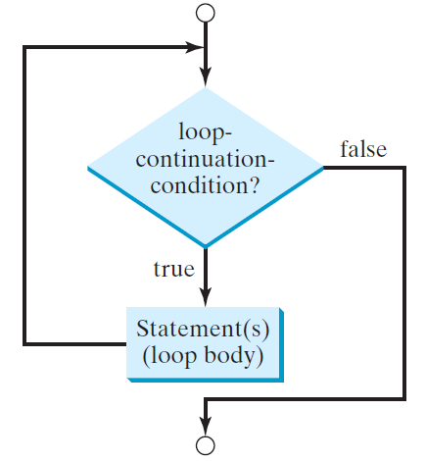
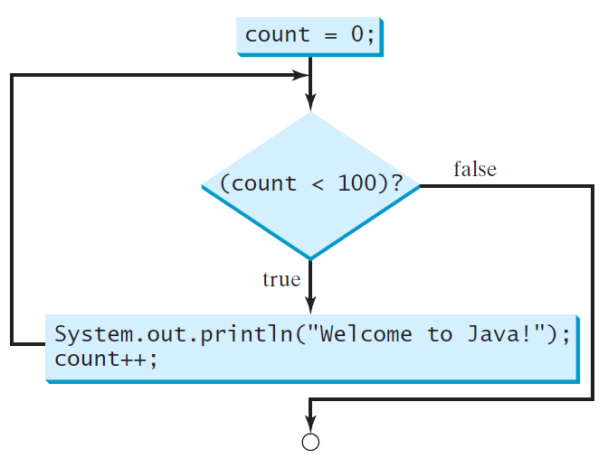
while Loop Flow Chart
int count = 0;
while (count < 100) {
System.out.println("Welcome to Java!");
count++;
}
while (loop-continuation-condition) {
// loop-body;
Statement(s);
}

Slide 7
Trace while Loop
animation
Initialize count
int count = 0;
while (count < 2) {
System.out.println("Welcome to Java!");
count++;
}

Slide 8
Trace while Loop, cont.
animation
(count < 2) is true
int count = 0;
while (count < 2) {
System.out.println("Welcome to Java!");
count++;
}

Slide 9
Trace while Loop, cont.
animation
Print Welcome to Java
int count = 0;
while (count < 2) {
System.out.println("Welcome to Java!");
count++;
}

Slide 10
Trace while Loop, cont.
animation
Increase count by 1
count is 1 now
int count = 0;
while (count < 2) {
System.out.println("Welcome to Java!");
count++;
}

Slide 11
Trace while Loop, cont.
animation
(count < 2) is still true since count is 1
int count = 0;
while (count < 2) {
System.out.println("Welcome to Java!");
count++;
}

Slide 12
Trace while Loop, cont.
animation
Print Welcome to Java
int count = 0;
while (count < 2) {
System.out.println("Welcome to Java!");
count++;
}

Slide 13
Trace while Loop, cont.
animation
Increase count by 1
count is 2 now
int count = 0;
while (count < 2) {
System.out.println("Welcome to Java!");
count++;
}

Slide 14
Trace while Loop, cont.
animation
(count < 2) is false since count is 2 now
int count = 0;
while (count < 2) {
System.out.println("Welcome to Java!");
count++;
}

Slide 15
Trace while Loop
animation
The loop exits. Execute the next statement after the loop.
int count = 0;
while (count < 2) {
System.out.println("Welcome to Java!");
count++;
}

Slide 16
Problem: Repeat Addition Until Correct
Recall that Listing 3.1 AdditionQuiz.java gives a program that prompts the user to enter an answer for a question on addition of two single digits. Using a loop, you can now rewrite the program to let the user enter a new answer until it is correct.
IMPORTANT NOTE: If you cannot run the buttons, see https://liveexample.pearsoncmg.com/slide/javaslidenote.doc.
RepeatAdditionQuiz
Run

Slide 17
Problem: Guessing Numbers
Write a program that randomly generates an integer between 0 and 100, inclusive. The program prompts the user to enter a number continuously until the number matches the randomly generated number. For each user input, the program tells the user whether the input is too low or too high, so the user can choose the next input intelligently. Here is a sample run:
GuessNumberOneTime
Run
GuessNumber
Run

Slide 18
Problem: An Advanced Math Learning Tool
The Math subtraction learning tool program generates just one question for each run. You can use a loop to generate questions repeatedly. This example gives a program that generates five questions and reports the number of the correct answers after a student answers all five questions.
SubtractionQuizLoop
Run

Slide 19
Ending a Loop with a Sentinel Value
Often the number of times a loop is executed is not predetermined. You may use an input value to signify the end of the loop. Such a value is known as a sentinel value.
Write a program that reads and calculates the sum of an unspecified number of integers. The input 0 signifies the end of the input.
SentinelValue
Run

Slide 20
Caution
Don’t use floating-point values for equality checking in a loop control. Since floating-point values are approximations for some values, using them could result in imprecise counter values and inaccurate results. Consider the following code for computing 1 + 0.9 + 0.8 + ... + 0.1:
double item = 1; double sum = 0;
while (item != 0) { // No guarantee item will be 0
sum += item;
item -= 0.1;
}
System.out.println(sum);

Slide 21
☑ Check Point
Analyze the following code. Is count < 100 always true, always false, or sometimes true or sometimes false at Point A, Point B, and Point C? int count = 0; while (count < 100) { // Point A System.out.println("Welcome to Java!"); count++; // Point B } // Point C
<--- ANSWER --->
count < 100 is always true at Point A. count < 100 always false at Point C. count < 100 is sometimes true or sometimes false at Point B.

Slide 22
☑ Check Point
How many times are the following loop bodies repeated? What is the output of each loop? (a) int i = 1; (b) int i = 1; while (i < 10) while (i < 10) if (i % 2 == 0) if (i % 2 == 0) System.out.println(i); System.out.println(i++); (c) int i = 1; while (i < 10) if ((i++) % 2 == 0) System.out.println(i);
<--- ANSWER --->
(a) Infinite number of times.
(b) Infinite number of times.
(c) The loop body is executed nine times. The output is 3, 5, 7, 9 on separate lines.

Slide 23
☑ Check Point
What is the output of the following code? Explain the reason. int x = 80000000; while (x > 0) x++; System.out.println("x is " + x);
<--- ANSWER --->
x is -2147483648 The reason: When a variable is assigned a value that is too large (in size) to be stored, it causes overflow. 2147483647 + 1 is actually -2147483648

Slide 24
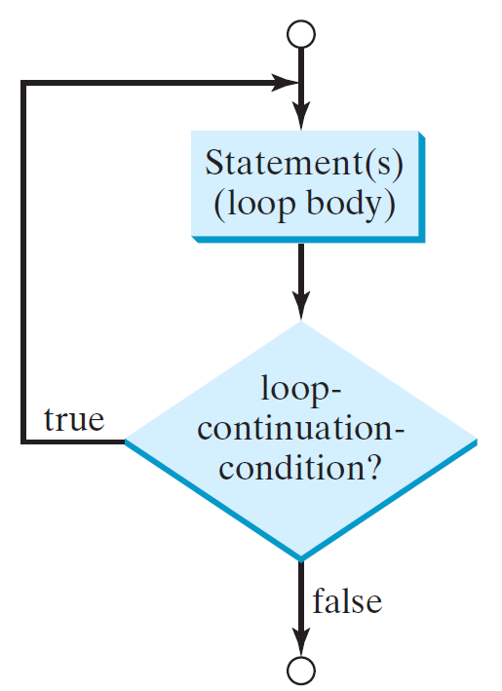
do-while Loop
do {
// Loop body;
Statement(s);
} while (loop-continuation-condition);

Slide 25
☑ Check Point
1 import java.util.Scanner; 2 3 public class GuessNumber { 4 public static void main(String[] args) { 5 // Generate a random number to be guessed 6 int number = (int)(Math.random() * 101); 7 8 Scanner input = new Scanner(System.in); 9 System.out.println("Guess a magic number between 0 and 100"); 10 11 int guess = -1; 12 while (guess != number) { 13 // Prompt the user to guess the number 14 System.out.print("\nEnter your guess: "); 15 guess = input.nextInt(); 16 17 if (guess == number) 18 System.out.println("Yes, the number is " + number); 19 else if (guess > number) 20 System.out.println("Your guess is too high"); 21 else 22 System.out.println("Your guess is too low"); 23 } // End of loop 24 } 25 }
What is wrong if guess is initialized to 0 in line 11? <--- ANSWER --->
It would be wrong if it is initialized to a value between 0 and 100, because it could be the number you attempt to guess.

Slide 26
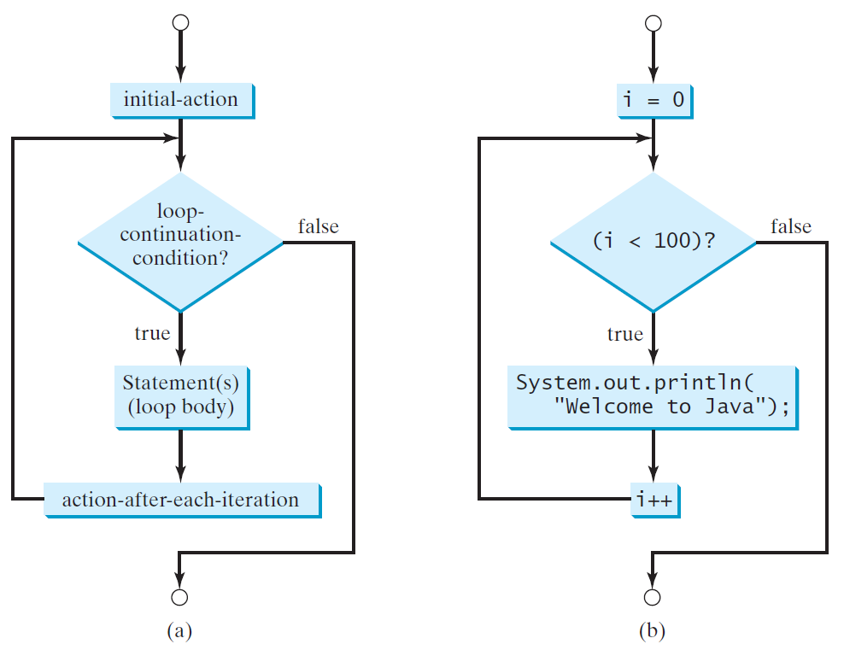
for Loops
for (initial-action; loop-continuation-condition; action-after-each-iteration) {
// loop body;
Statement(s);
}
int i;
for (i = 0; i < 100; i++) {
System.out.println(
"Welcome to Java!");
}

Slide 27
Trace for Loop
animation
Declare i
int i;
for (i = 0; i < 2; i++) {
System.out.println(
"Welcome to Java!");
}

Slide 28
Trace for Loop, cont.
animation
Execute initializer
i is now 0
int i;
for (i = 0; i < 2; i++) {
System.out.println(
"Welcome to Java!");
}

Slide 29
Trace for Loop, cont.
animation
(i < 2) is true
since i is 0
int i;
for (i = 0; i < 2; i++) {
System.out.println( "Welcome to Java!");
}

Slide 30
Trace for Loop, cont.
animation
Print Welcome to Java
int i;
for (i = 0; i < 2; i++) {
System.out.println("Welcome to Java!");
}

Slide 31
Trace for Loop, cont.
animation
Execute adjustment statement
i now is 1
int i;
for (i = 0; i < 2; i++) {
System.out.println("Welcome to Java!");
}

Slide 32
Trace for Loop, cont.
animation
(i < 2) is still true
since i is 1
int i;
for (i = 0; i < 2; i++) {
System.out.println("Welcome to Java!");
}

Slide 33
Trace for Loop, cont.
animation
Print Welcome to Java
int i;
for (i = 0; i < 2; i++) {
System.out.println("Welcome to Java!");
}

Slide 34
Trace for Loop, cont.
animation
Execute adjustment statement
i now is 2
int i;
for (i = 0; i < 2; i++) {
System.out.println("Welcome to Java!");
}

Slide 35
Trace for Loop, cont.
animation
(i < 2) is false
since i is 2
int i;
for (i = 0; i < 2; i++) {
System.out.println("Welcome to Java!");
}

Slide 36
Trace for Loop, cont.
animation
Exit the loop. Execute the next statement after the loop
int i;
for (i = 0; i < 2; i++) {
System.out.println("Welcome to Java!");
}

Slide 37
Note
The initial-action in a for loop can be a list of zero or more comma-separated expressions. The action-after-each-iteration in a for loop can be a list of zero or more comma-separated statements. Therefore, the following two for loops are correct. They are rarely used in practice, however.
for (int i = 1; i < 100; System.out.println(i++));
for (int i = 0, j = 0; (i + j < 10); i++, j++) {
// Do something
}

Slide 38
Note
If the loop-continuation-condition in a for loop is omitted, it is implicitly true. Thus, the statement given below in (a), which is an infinite loop, is correct. Nevertheless, it is better to use the equivalent loop in (b) to avoid confusion:

Slide 39
Caution
Adding a semicolon at the end of the for clause before the loop body is a common mistake, as shown below:
Logic Error
for (int i=0; i<10; i++);
{
System.out.println("i is " + i);
}

Slide 40
Caution, cont.
Similarly, the following loop is also wrong:
int i=0;
while (i < 10);
{
System.out.println("i is " + i);
i++;
}
In the case of the do loop, the following semicolon is needed to end the loop.
int i=0;
do {
System.out.println("i is " + i);
i++;
} while (i<10);
Logic Error
Correct

Slide 41
Which Loop to Use?
The three forms of loop statements, while, do-while, and for, are expressively equivalent; that is, you can write a loop in any of these three forms. For example, a while loop in (a) in the following figure can always be converted into the following for loop in (b):
A for loop in (a) in the following figure can generally be converted into the following while loop in (b) except in certain special cases (see Review Question 3.19 for one of them):

Slide 42
Recommendations
Use the one that is most intuitive and comfortable for you.
In general, a for loop may be used if the number of repetitions is known, as, for example, when you need to print a message 100 times.
A while loop may be used if the number of repetitions is not known, as in the case of reading the numbers until the input is 0.
A do-while loop can be used to replace a while loop if the loop body has to be executed before testing the continuation condition.

Slide 43
☑ Check Point
Suppose the input is 2 3 4 5 0. What is the output of the following code? import java.util.Scanner; public class Test { public static void main(String[] args) { Scanner input = new Scanner(System.in); int number, max; number = input.nextInt(); max = number; while (number != 0) { number = input.nextInt(); if (number > max) max = number; } System.out.println("max is " + max); System.out.println("number " + number); } }
<--- ANSWER --->
max is 5 number 0

Slide 44
Nested Loops
Problem: Write a program that uses nested for loops to print a multiplication table.
MultiplicationTable
Run

Slide 45
☑ Check Point
Suppose the input is 3 4 7 2 0. What is the output of the following code? import java.util.Scanner; public class Test { public static void main(String[] args) { Scanner input = new Scanner(System.in); int number, max; number = input.nextInt(); max = number; do { number = input.nextInt(); if (number > max) max = number; } while (number != 0); System.out.println("max is " + max); System.out.println("number " + number); } }
<--- ANSWER --->
max is 7 number 0

Slide 46
☑ Check Point
What are the differences between a while loop and a do-while loop? Convert the following while loop into a do-while loop. Scanner input = new Scanner(System.in); int sum = 0; System.out.println("Enter an integer " + "(the input ends if it is 0)"); int number = input.nextInt(); while (number != 0) { sum += number; System.out.println("Enter an integer " + "(the input ends if it is 0)"); number = input.nextInt(); }
<--- ANSWER --->
The difference between a do-while loop and a while loop is the order of evaluating the continuation-condition and executing the loop body. In a while loop, the continuation-condition is checked and then, if true, the loop body is executed. In a do-while loop, the loop body is executed for the first time before the continuation-condition is evaluated. Scanner input = new Scanner(System.in); int sum = 0; int number; do { System.out.println("Enter an integer " + "(the input ends if it is 0)"); number = input.nextInt(); sum += number; } while (number != 0);

Slide 47
☑ Check Point
Do the following two loops result in the same value in sum? (a) for (int i = 0; i < 10; ++i) { sum += i; } (b) for (int i = 0; i < 10; i++) { sum += i; }
<--- ANSWER --->
Same. When the i++ and ++i are used in isolation, their effects are same.

Slide 48
☑ Check Point
What are the three parts of a for loop control?
Write a for loop that prints the numbers from 1 to 100.
<--- ANSWER --->
The three parts in a for loop control are as follows: (1) The first part initializes the control variable. (2) The second part is a Boolean expression that determines whether the loop will repeat. (3) The third part is the adjustment statement, which adjusts the control variable.
for (int i = 1; i <= 100; i++) System.out.println(i);

Slide 49
☑ Check Point
Suppose the input is 2 3 4 5 0. What is the output of the following code? import java.util.Scanner; public class Test { public static void main(String[] args) { Scanner input = new Scanner(System.in); int number, sum = 0, count; for (count = 0; count < 5; count++) { number = input.nextInt(); sum += number; } System.out.println("sum is " + sum); System.out.println("count is " + count); } }
<--- ANSWER --->
sum is 14 count is 5

Slide 50
☑ Check Point
What does the following statement do? for ( ; ; ) { // Do something }
If a variable is declared in a for loop control, can it be used after the loop exits?
<--- ANSWER --->
The loop keeps doing something indefinitely.
No. The scope of the variable is inside the loop.

Slide 51
☑ Check Point
Convert the following for loop statement to a while loop and to a do-while loop: long sum = 0; for (int i = 0; i <= 1000; i++) sum = sum + i;
<--- ANSWER --->
while loop: do-while loop: long sum = 0; long sum = 0; int i=0; int i = 0; while (i <= 1000) { do { sum += i++; sum += i++; } } while (i <= 1000);

Slide 52
☑ Check Point
Count the number of iterations in the following loops. (a) int count = 0; (b) for (int count = 0; while (count < n) { count <= n; count++) { count++; } } (c) int count = 5; (d) int count = 5; while (count < n) { while (count < n) { count++; count = count + 3; } }
<--- ANSWER --->
(a) n times (b) n+1 times (c) n-5 times (d) The ceiling of (n-5)/3 times

Slide 53
☑ Check Point
Can you convert a for loop to a while loop? List the advantages of using for loops.
Can you always convert a while loop into a for loop? Convert the following while loop into a for loop. int i = 1; int sum = 0; while (sum < 10000) { sum = sum + i; i++; }
<--- ANSWER --->
Yes. When using a while loop, programmers often forget to adjust the control variable such as i++. Using for loop can avoid this error.
Yes. for (int i=1; sum < 10000; i++) sum = sum + i;

Slide 54
☑ Check Point
1 public class Test { 2 public void main(String[] args) { 3 for (int i = 0; i < 10; i++); 4 sum += i;
5
6 if (i < j);
7 System.out.println(i)
8 else
9 System.out.println(j);
10
11 while (j < 10);
12 {
13 j++;
14 }
15
16 do {
17 j++;
18 } while (j < 10)
19 }
20 }
Identify and fix the errors in the code given.
<--- ANSWER --->
Line 2: missing static. Line 3: The semicolon (;) at the end of the for loop heading should be removed. Line 4: sum not defined. Line 6: the semicolon (;) at the end of the if statement should be removed. Line 6: j not defined. Line 7: Missing a semicolon for the first println statement. Line 11: The semicolon (;) at the end of the while heading should be removed. Line 18: Missing a semicolon at the end of the do-while loop.

Slide 55
☑ Check Point
What is wrong with the following programs? (a) 1 public class ShowErrors { 2 public static void main(String[] args) { 3 int i = 0; 4 do { 5 System.out.println(i + 4); 6 i++; 7 } 8 while (i < 10) 9 } 10 }
(b) 1 public class ShowErrors { 2 public static void main(String[] args) { 3 for (int i = 0; i < 10; i++); 4 System.out.println(i + 4); 5 } 6 }
<--- ANSWER --->
(a) Line 8: Missing ; at the end of this line.
(b) Line 3: The ; at the end of for loop should be removed. for (int i = 0; i < 10; i++);

Slide 56
☑ Check Point
How many times is the println statement executed? for (int i = 0; i < 10; i++) for (int j = 0; j < i; j++) System.out.println(i * j)
<--- ANSWER --->
When i is 0, the println statement is not executed. When i is 1, the println statement is executed once. When i is 2, the println statement is executed two times. When i is 3, the println statement is executed three times. When i is 9, the println statement is executed nine times. So, the total is 0 + 1 + 2 + 3 + 4 + 5 + 6 + 7 + 8 + 9 = 45

Slide 57
☑ Check Point
Show the output of the following program. (Hint: Draw a table and list the variables in the columns to trace these program.) public class Test { public static void main(String[] args) { for (int i = 1; i < 5; i++) { int j = 0; while (j < i) { System.out.print(j + " "); j++; } } } }
<--- ANSWER --->
0 0 1 0 1 2 0 1 2 3
Tip for tracing programs: Draw a table to see how variables change in the program. i j output 1 0 0 1 1 2 0 0 2 1 1 2 2 3 0 0 3 1 1 3 2 2 3 3 4 0 0 4 1 1 4 2 2 4 3 3 4 4

Slide 58
☑ Check Point
Show the output of the following program. public class Test { public static void main(String[] args) { int i = 0; while (i < 5) { for (int j = i; j > 1; j--) System.out.print(j + " "); System.out.println("****"); i++; } } }
<--- ANSWER --->
**** **** 2 **** 3 2 **** 4 3 2 ****

Slide 59
☑ Check Point
Show the output of the following program. public class Test { public static void main(String[] args) { int i = 5; while (i >= 1) { int num = 1; for (int j = 1; j <= i; j++) { System.out.print(num + "xxx"); num *= 2; } System.out.println(); i--; } } }
<--- ANSWER --->
1xxx2xxx4xxx8xxx16xxx 1xxx2xxx4xxx8xxx 1xxx2xxx4xxx 1xxx2xxx 1xxx

Slide 60
☑ Check Point
Show the output of the following program. public class Test { public static void main(String[] args) { int i = 1; do { int num = 1; for (int j = 1; j <= i; j++) { System.out.print(num + "G"); num += 2; } System.out.println(); i++; } while (i <= 5); } }
<--- ANSWER --->
1G 1G3G 1G3G5G 1G3G5G7G 1G3G5G7G9G

Slide 61
Minimizing Numerical Errors
Numeric errors involving floating-point numbers are inevitable. This section discusses how to minimize such errors through an example.
Here is an example that sums a series that starts with 0.01 and ends with 1.0. The numbers in the series will increment by 0.01, as follows: 0.01 + 0.02 + 0.03 and so on.
TestSum
Run

Slide 62
Problem: Finding the Greatest Common Divisor
Problem: Write a program that prompts the user to enter two positive integers and finds their greatest common divisor.
Solution: Suppose you enter two integers 4 and 2, their greatest common divisor is 2. Suppose you enter two integers 16 and 24, their greatest common divisor is 8. So, how do you find the greatest common divisor?
Let the two input integers be n1 and n2. You know number 1 is a common divisor, but it may not be the greatest common divisor. So, you can check whether k (for k = 2, 3, 4, and so on) is a common divisor for n1 and n2, until k is greater than n1 or n2.
GreatestCommonDivisor
Run

Slide 63
Problem: Predicting the Future Tuition
Problem: Suppose that the tuition for a university is $10,000 this year and tuition increases 7% every year. In how many years will the tuition be doubled?
FutureTuition
Run

Slide 64
Problem: Predicating the Future Tuition
double tuition = 10000; int year = 0 // Year 0
tuition = tuition * 1.07; year++; // Year 1
tuition = tuition * 1.07; year++; // Year 2
tuition = tuition * 1.07; year++; // Year 3
...

Slide 65
Case Study: Converting Decimals to Hexadecimals
Hexadecimals are often used in computer systems programming (see Appendix F for an introduction to number systems). How do you convert a decimal number to a hexadecimal number? To convert a decimal number d to a hexadecimal number is to find the hexadecimal digits h_{n}, h_{n-1}, h_{n-2}, ... , h₂, h₁, and h₀ such that
These hexadecimal digits can be found by successively dividing d by 16 until the quotient is 0. The remainders are h₀, h₁, h₂, ... , h_{n-2}, h_{n-1}, and h_{n}.
Dec2Hex
Run

Slide 66
Problem: Monte Carlo Simulation
Companion Website
The Monte Carlo simulation refers to a technique that uses random numbers and probability to solve problems. This method has a wide range of applications in computational mathematics, physics, chemistry, and finance. This section gives an example of using the Monto Carlo simulation for estimating π.
circleArea / squareArea = π / 4.
π can be approximated as 4 * numberOfHits / numberOfTrials
MonteCarloSimulation
Run

Slide 67
☑ Check Point
1 import java.util.Scanner;
2
3 public class GreatestCommonDivisor {
4 /** Main method */
5 public static void main(String[] args) {
6 // Create a Scanner
7 Scanner input = new Scanner(System.in);
8
9 // Prompt the user to enter two integers
10 System.out.print("Enter first integer: ");
11 int n1 = input.nextInt();
12 System.out.print("Enter second integer: ");
13 int n2 = input.nextInt();
14
15 int gcd = 1; // Initial gcd is 1
16 int k = 2; // Possible gcd
17 while (k <= n1 && k <= n2) {
18 if (n1 % k == 0 && n2 % k == 0)
19 gcd = k; // Update gcd
20 k++;
21 }
22
23 System.out.println("The greatest common divisor for " + n1 +
24 " and " + n2 + " is " + gcd);
25 }
26 }
Will the program work if n1 and n2 are replaced by n1 / 2 and n2 / 2 in line 17?
<--- ANSWER --->
No. Try n1 = 3 and n2 =3.

Slide 68
☑ Check Point
1 import java.util.Scanner;
3 public class Dec2Hex {
4 /** Main method */
5 public static void main(String[] args) {
6 // Create a Scanner
7 Scanner input = new Scanner(System.in);
9 // Prompt the user to enter a decimal integer
10 System.out.print("Enter a decimal number: ");
11 int decimal = input.nextInt();
13 // Convert decimal to hex
14 String hex = "";
15
16 while (decimal != 0) {
17 int hexValue = decimal % 16;
18
19 // Convert a decimal value to a hex digit
20 char hexDigit = (hexValue <= 9 && hexValue >= 0) ?
21 (char)(hexValue + '0') : (char)(hexValue - 10 + 'A');
22
23 hex = hexDigit + hex;
24 decimal = decimal / 16;
25 }
26
27 System.out.println("The hex number is " + hex);
28 }
29 }
Why is it wrong if you change the code (char)(hexValue + '0') to hexValue + '0' in line 21?
How many times the loop body is executed for a decimal number 245 and how many times the loop body is executed for a decimal number 3245?
<--- ANSWER --->
Possible loss of precision for int to char.
The number of digits in the hex number determines the number of times the loop is executed. 245 is F5 in hex. So, the loop body is executed 2 times. 3245 is CAD in hex. So, the loop body is executed 3 times.

Slide 69
☑ Check Point
What is the hex number after E?
What is the hex number after F?
<--- ANSWER --->
The hex number after E is F.
The hex number after F is 10.

Slide 70
☑ Check Point
1 import java.util.Scanner;
3 public class Dec2Hex {
4 /** Main method */
5 public static void main(String[] args) {
6 // Create a Scanner
7 Scanner input = new Scanner(System.in);
9 // Prompt the user to enter a decimal integer
10 System.out.print("Enter a decimal number: ");
11 int decimal = input.nextInt();
13 // Convert decimal to hex
14 String hex = "";
15
16 while (decimal != 0) {
17 int hexValue = decimal % 16;
18
19 // Convert a decimal value to a hex digit
20 char hexDigit = (hexValue <= 9 && hexValue >= 0) ?
21 (char)(hexValue + '0') : (char)(hexValue - 10 + 'A');
22
23 hex = hexDigit + hex;
24 decimal = decimal / 16;
25 }
26
27 System.out.println("The hex number is " + hex);
28 }
29 }
What will be the output if the input is 0? Revise line 27 so that the program displays hex number 0 if the input decimal is 0.
<--- ANSWER --->
If the input is 0, the value in variable hex will be an empty string. This is an error. To fix it, use System.out.println("The hex number is " + (hex.length() == 0 ? "0" : hex)); <--or--> if (hex.length() == 0) System.out.println("The hex number is 0"); else System.out.println("The hex number is " + hex);

Slide 71
Using break and continue
Examples for using the break and continue keywords:
TestBreak.java
TestBreak
Run
TestContinue.java
TestContinue
Run

Slide 72
break
public class TestBreak {
public static void main(String[] args) {
int sum = 0;
int number = 0;
while (number < 20) {
number++;
sum += number;
if (sum >= 100)
break;
}
System.out.println("The number is " + number);
System.out.println("The sum is " + sum);
}
}

Slide 73
continue
public class TestContinue {
public static void main(String[] args) {
int sum = 0;
int number = 0;
while (number < 20) {
number++;
if (number == 10 || number == 11)
continue;
sum += number;
}
System.out.println("The sum is " + sum);
}
}

Slide 74
Guessing Number Problem Revisited
Here is a program for guessing a number. You can rewrite it using a break statement.
GuessNumberUsingBreak
Run

Slide 75
☑ Check Point
What is the keyword break for?
What is the keyword continue for?
Will the following programs terminate? If so, give the output. (a) (b) int balance = 10; int balance = 10; while (true) { while (true) { if (balance < 9) if (balance < 9) break; continue; balance = balance - 9; balance = balance - 9; } } System.out.println("Balance is " System.out.println("Balance is " + balance); + balance);
<--- ANSWER --->
The keyword break is used to exit the current loop.
The keyword continue causes the rest of the loop body to be skipped for the current iteration.
The program in (a) will terminate. The output -> Balance is 1 The while loop (b) will not terminate.

Slide 76
☑ Check Point
The for loop in (a) is converted into the while loop in (b). What is wrong? Correct it. (a) int sum = 0; (b) int i = 0, sum = 0; for (int i = 0; i < 4; i++) { while (i < 4) { if (i % 3 == 0) continue; if (i % 3 == 0) continue; sum += i; sum += i; } i++; }
<--- ANSWER --->
If a continue statement is executed inside a for loop, the rest of the iteration is skipped, then the action-after-each-iteration is performed, and the loop-continuation-condition is checked. If a continue statement is executed inside a while loop, the rest of the iteration is skipped, then the loop-continuation-condition is checked. Here is the fix: int i = 0, sum = 0; while (i < 4) { if (i % 3 == 0) { i++; continue; } sum += i; i++; }

Slide 77
☑ Check Point
1 public class TestBreak {
2 public static void main(String[] args) {
3 int sum = 0;
4 int number = 0;
5
6 while (number < 20) {
7 number++;
8 sum += number;
9 if (sum >= 100)
10 break;
11 }
12
13 System.out.println("The number is " + number);
14 System.out.println("The sum is " + sum);
15 }
16 }
Rewrite the program TestBreak without using break and continue.
<--- ANSWER --->
class TestBreak { public static void main(string[]args) { int sum = 0; int number = 0; while (number < 20 && sum < 100) { number++; sum += number; } System.out.println("The sum is " + sum); } }

Slide 78
☑ Check Point
1 public class TestContinue {
2 public static void main(String[] args) {
3 int sum = 0;
4 int number = 0;
5
6 while (number < 20) {
7 number++;
8 if (number ==10 || number == 11)
9 continue;
10 sum += number;
11 }
12
13 System.out.println("The sum is " + sum);
14 }
15 }
Rewrite the program TestContinue without using break and continue.
<--- ANSWER --->
class TestContinue { public static void main(String[] args) { int sum = 0; int number = 0; while (number < 20) { number++; if (number != 10 && number != 11) sum += number; } System.out.println("The sum is " + sum); } }

Slide 79
☑ Check Point
After the break statement is executed in the following loop, which statement is executed? Show the output. for (int i = 1; i < 4; i++) { for (int j = 1; j < 4; j++) { if (i * j > 2) break; System.out.println(i * j); } System.out.println(i); }
<--- ANSWER --->
After the break statement is executed, the last println statement is executed. The output of this fragment is 1 2 1 2 2 3

Slide 80
☑ Check Point
After the continue statement is executed in the following loop, which statement is executed? Show the output. for (int i = 1; i < 4; i++) { for (int j = 1; j < 4; j++) { if (i * j > 2) continue; System.out.println(i * j); } System.out.println(i); }
<--- ANSWER --->
After the continue statement is executed, the statement j++ will be executed. The output of this fragment is 1 2 1 2 2 3

Slide 81
Problem: Checking Palindrome
A string is a palindrome if it reads the same forward and backward. The words “mom,” “dad,” and “noon,” for instance, are all palindromes.
The problem is to write a program that prompts the user to enter a string and reports whether the string is a palindrome. One solution is to check whether the first character in the string is the same as the last character. If so, check whether the second character is the same as the second-to-last character. This process continues until a mismatch is found or all the characters in the string are checked, except for the middle character if the string has an odd number of characters.
Palindrome
Run

Slide 82
Problem: Displaying Prime Numbers
Problem: Write a program that displays the first 50 prime numbers in five lines, each of which contains 10 numbers. An integer greater than 1 is prime if its only positive divisor is 1 or itself. For example, 2, 3, 5, and 7 are prime numbers, but 4, 6, 8, and 9 are not.
Solution: The problem can be broken into the following tasks:
For number = 2, 3, 4, 5, 6, ..., test whether the number is prime.
Determine whether a given number is prime.
Count the prime numbers.
Print each prime number, and print 10 numbers per line.
PrimeNumber
Run

Slide 83
☑ Check Point
1 import java.util.Scanner;
2
3 public class Palindrome {
4 /** Main method */
5 public static void main(String[] args) {
6 // Create a Scanner
7 Scanner input = new Scanner(System.in);
8
9 // Prompt the user to enter a string
10 System.out.print("Enter a string: ");
11 String s = input.nextLine();
12
13 // The index of the first character in the string
14 int low = 0;
15
16 // The index of the last character in the string
17 int high = s.length() - 1;
18
19 boolean isPalindrome = true;
20 while (low < high) {
21 if (s.charAt(low) != s.charAt(high)) {
22 isPalindrome = false;
23 break;
24 }
25
26 low++;
27 high--;
28 }
What happens to the program if (low < high) in line 20 is changed to (low <= high)?
<--- ANSWER --->
The program will work just fine, but there is no need to check for the case when low is equal to high. Obviously, the change is unnecessary and not good.
29
30 if (isPalindrome)
31 System.out.println(s + " is a palindrome");
32 else
33 System.out.println(s + " is not a palindrome");
34 }
35 }

Slide 84
☑ Check Point
1 public class PrimeNumber {
2 public static void main(String[] args) {
3 final int NUMBER_OF_PRIMES = 50; // Number of primes to display
4 final int NUMBER_OF_PRIMES_PER_LINE = 10; // Display 10 per line
5 int count = 0; // Count the number of prime numbers
6 int number = 2; // A number to be tested for primeness
7
8 System.out.println("The first 50 prime numbers are \n");
9
10 // Repeatedly find prime numbers
11 while (count < NUMBER_OF_PRIMES) {
12 // Assume the number is prime
13 boolean isPrime = true; // Is the current number prime?
14
15 // Test whether number is prime
16 for (int divisor = 2; divisor <= number / 2; divisor++) {
17 if (number % divisor == 0) { // If true, number is not prime
18 isPrime = false; // Set isPrime to false
19 break; // Exit the for loop
20 }
21 }
22
23 // Display the prime number and increase the count
24 if (isPrime) {
25 count++; // Increase the count
26
Simplify the code in lines 27-32 using a conditional operator.
<--- ANSWER --->
System.out.print(count % NUMBER_OF_PRIMES_PER_LINE == 0 ? number + "\n" : number + " ");
27 if (count % NUMBER_OF_PRIMES_PER_LINE == 0) {
28 // Display the number and advance to the new line
29 System.out.println(number);
30 }
31 else
32 System.out.print(number + " ");
33 }
34
35 // Check if the next number is prime
36 number++;
37 }
38 }
39 }
40 }

Slide 85
Debugging Loops in IDE Tools
Companion Website
Supplements II.C, II.E, and II.G.

